Slide 1

AMAZING BIKE
Self-Balancing-System

Slide 2






Team
Supervisor
MR. HOANG XUAN SON
Teamleader
QA Leader
Technical Leader
Developer
Developer
TRONG THINH
TRAN TUAN
TIEN TRUNG
VIET SON
QUANG QUYEN

Slide 3
Contents
1
Introduction
2
Project Implementation Overview
3
Research and Study
4
Product Demo
5
Question And Answer

Slide 4
1.
Introduce
1.1
Problem
1.2
Ideas

Slide 5

1.1
Problem

Slide 6
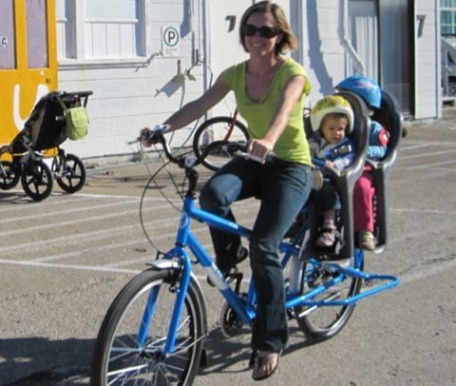
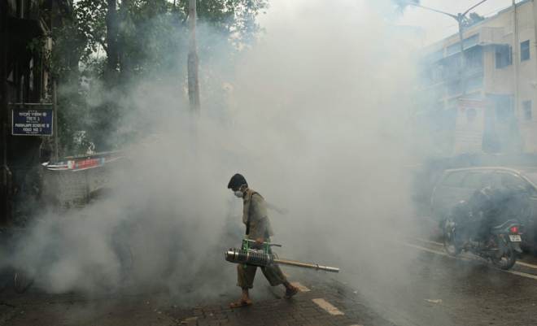
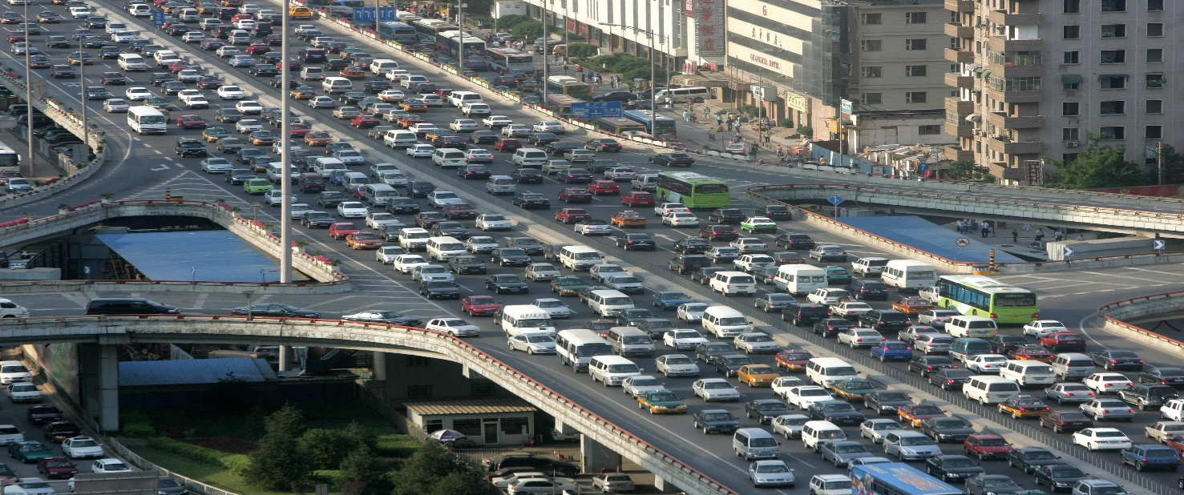
1.1
Problem
Shuttle children
Area poisoning survey
The growth of traffic

Slide 7
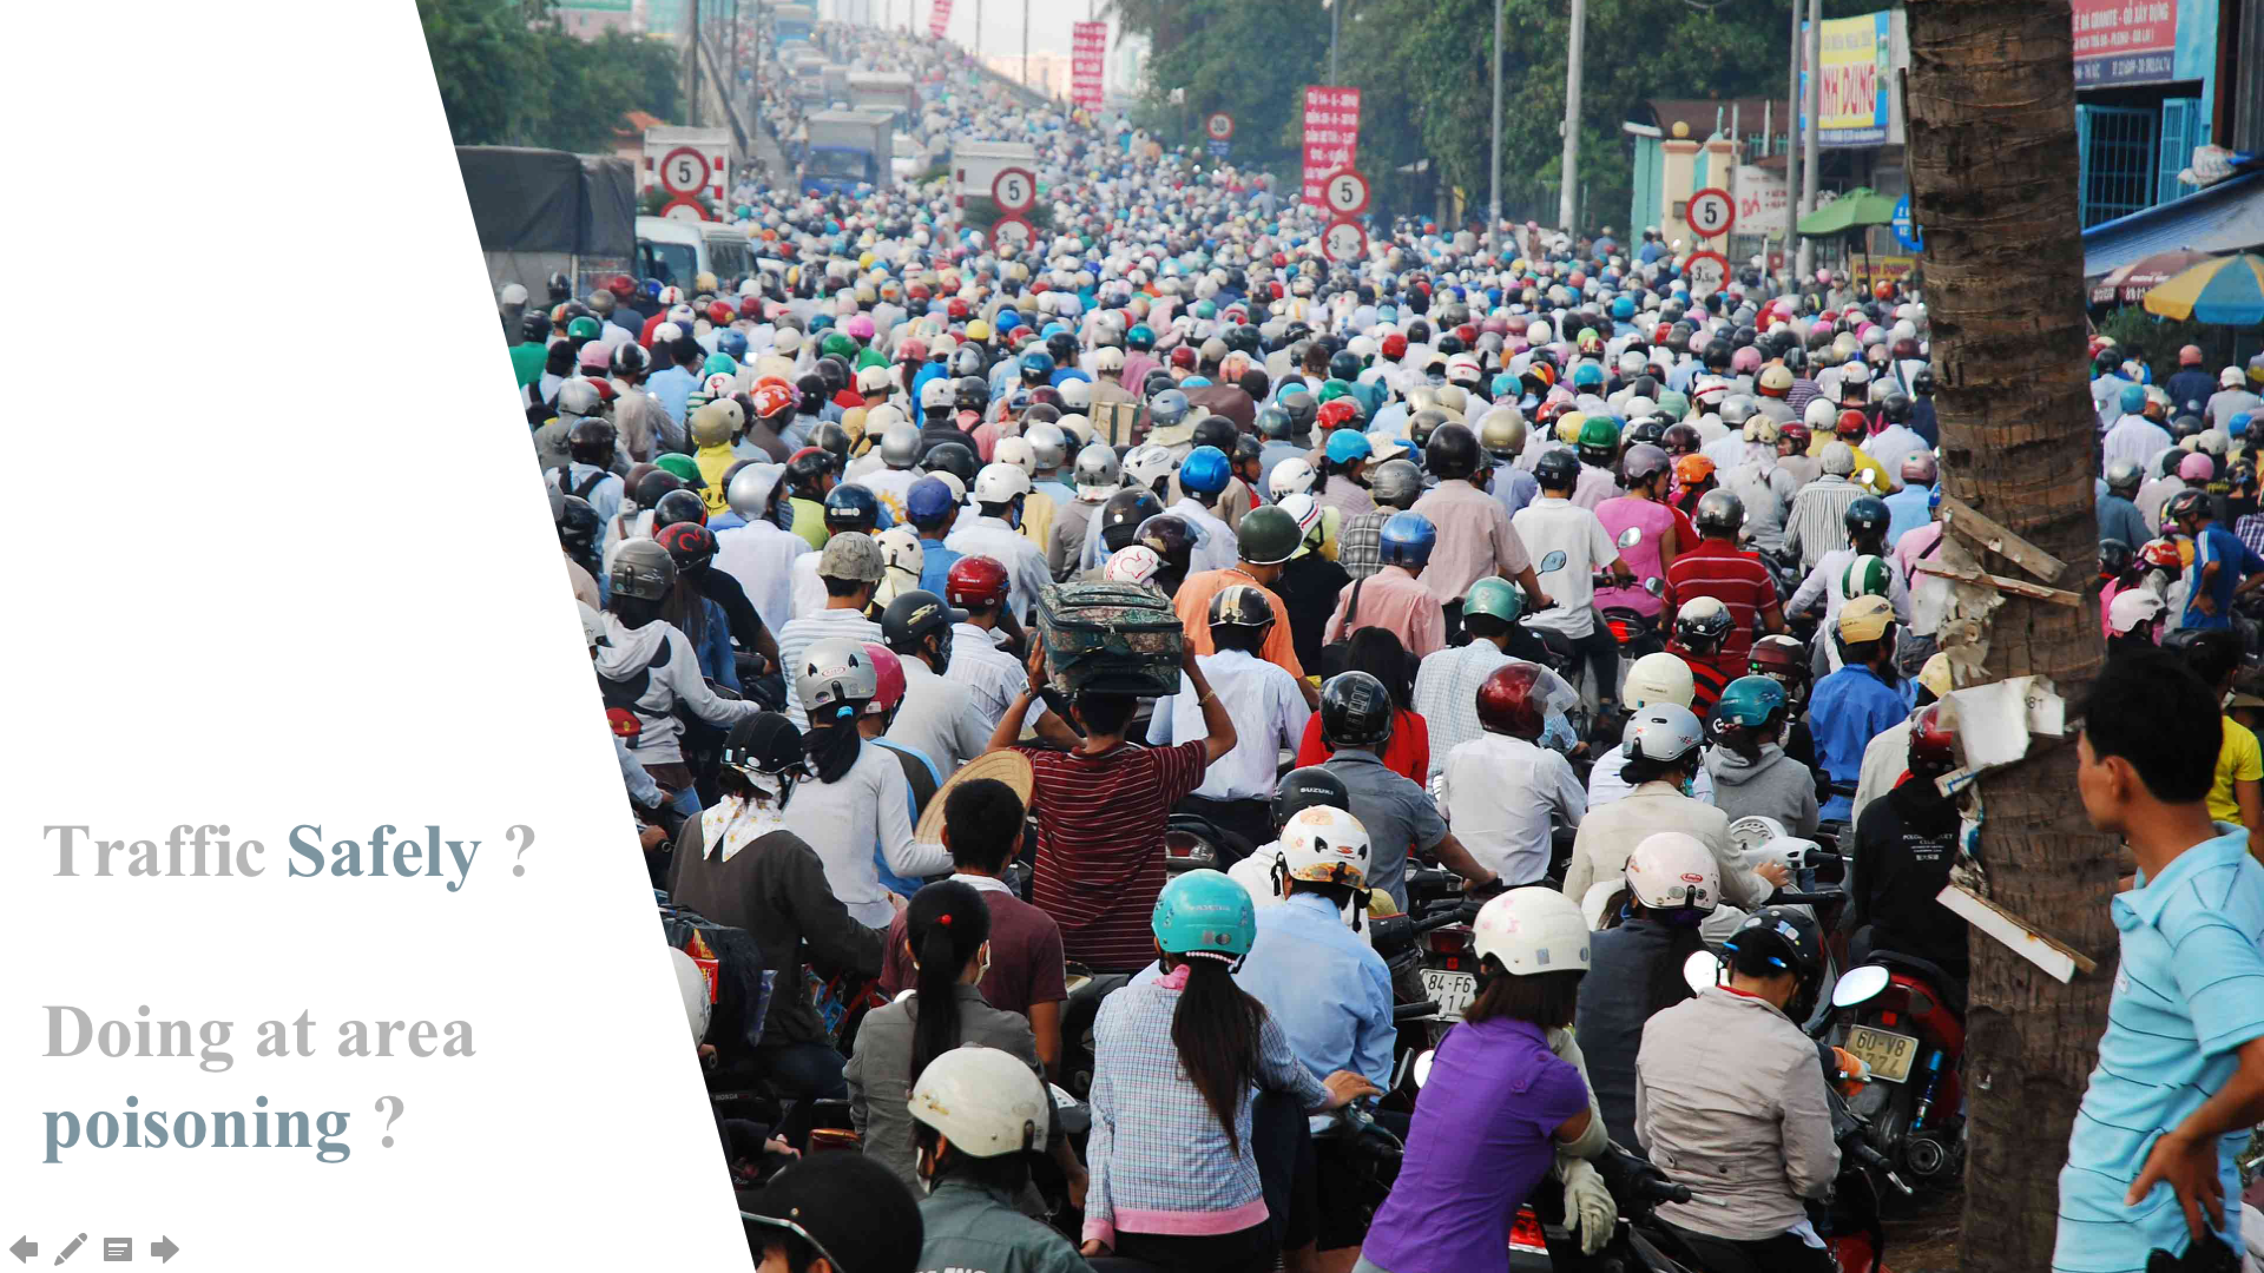
Traffic Safely ? Doing at area poisoning ?

Slide 8
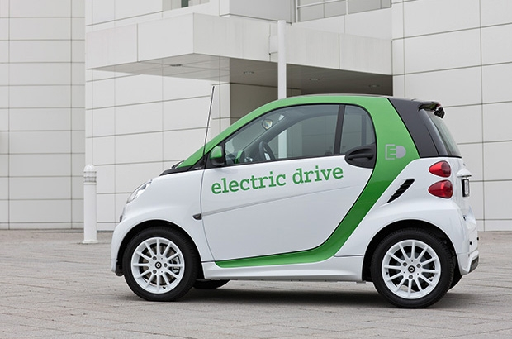
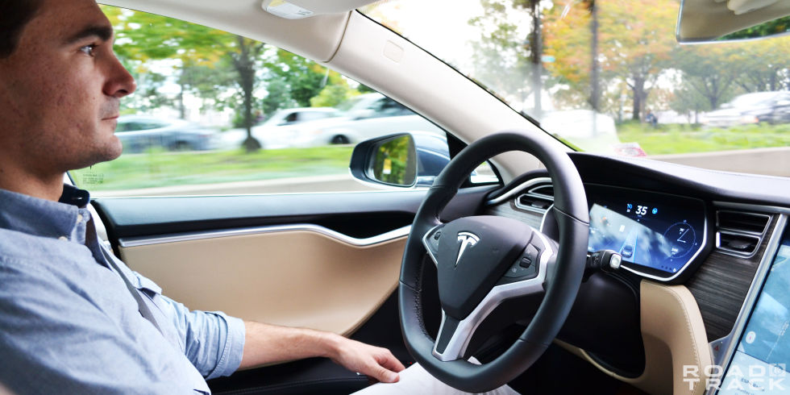
1.2
Ideas
Electric Cars
Self-driving cars of Tesla

Slide 9
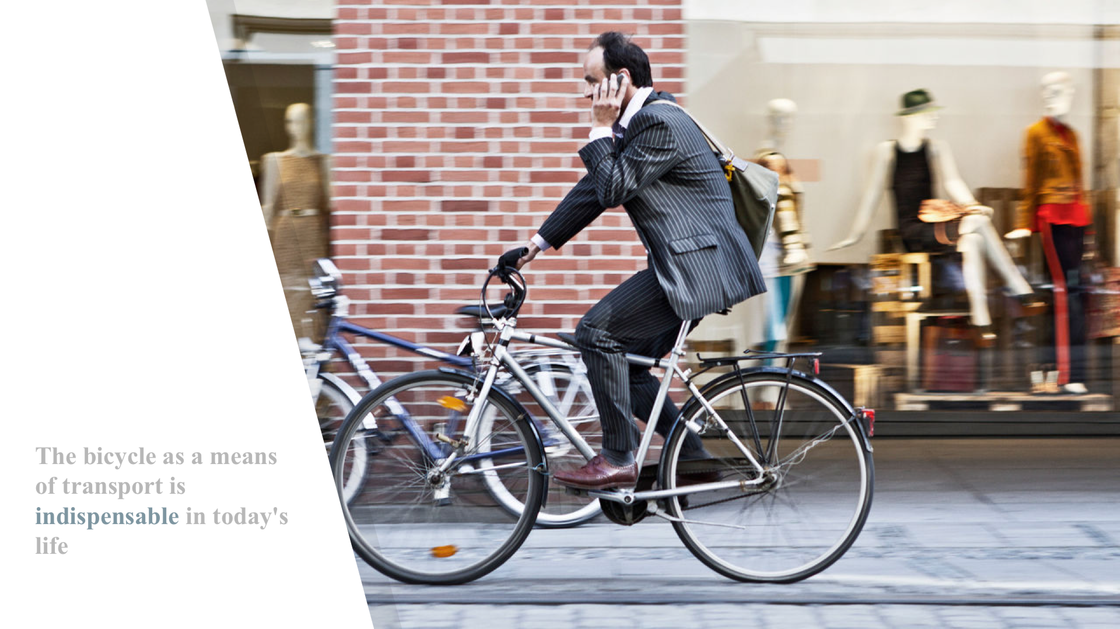
The bicycle as a means of transport is indispensable in today's life

Slide 10
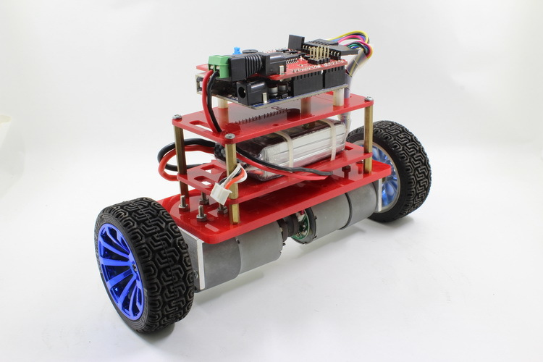
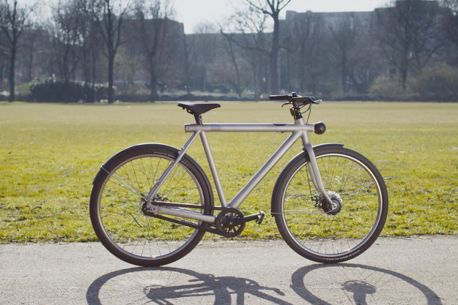
1.2
Ideas

Slide 11
2.
PROJECT IMPLEMENTATION OVERVIEW
2.1
System Development Plan
2.2
Development Tools
2.3
Risk Management Plan
2.4
Risk Management Plan
2.5
Requirements

Slide 12
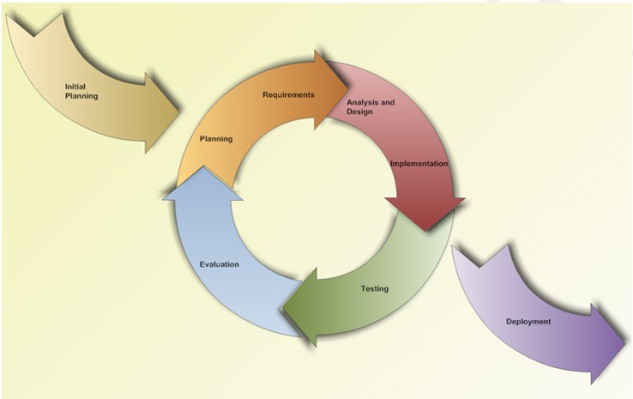
2.1
System
Development
Plan
Iterative and incremental development process model

Slide 13

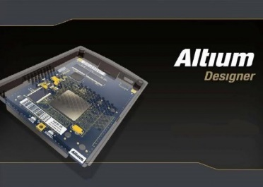







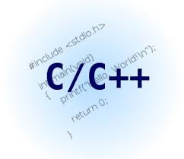


2.2
Development
Tools

Slide 14
2.3 Risk Management Plan
Risk ID | Avoiding plan | Fallback plan | Contingency plan | Schedule
R1 | - PM need contact to stakeholder so that he can aware of changes ASAP. | - Should prepare a list of other suppliers. | - Use chips, modules from other suppliers with similar functions. | - Project manager. - Contacts, regularly updated information from the suppliers.
R3 | - PM should estimate workforce needed for the project and able reserve members if needed. | - Assign clearly jobs based on the capacity of the group members. | - A few excellent members may undertake other work more to complete the project. | - Project manager. - Estimate workforce needed for the project.
R8 | - PM should discuss with developer team to find solution. | - Testing new technologies, modern equipment | - Finding supporting from expert | - Project manager and team member. - Organizing important meeting.

Slide 15
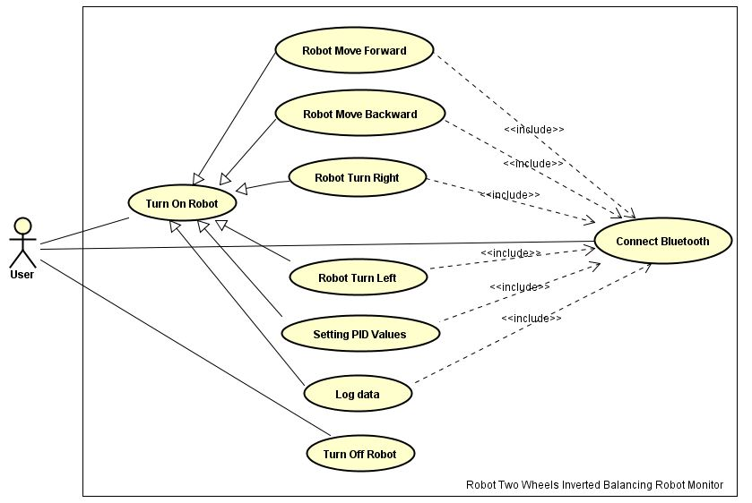
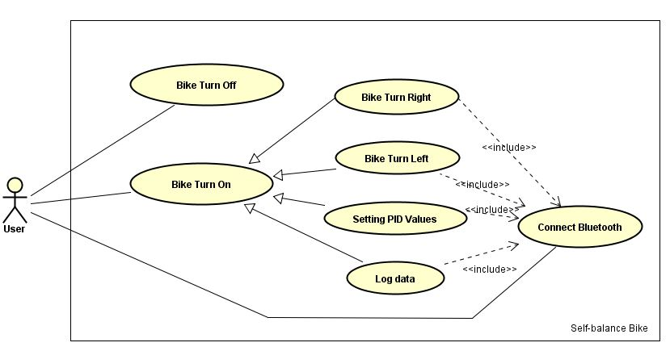
2.4 Requirement Specification
Functional Requirement

Slide 16





2.4 Requirement Specification
Non-Functional Requirement
01
03
Reliability
Maintainability
There is at least 99.9% of user command that will be successfully sent to the robot.
Balancing accuracy of PID algorithms is at least 99% when it does not receive any external disturbance.
Flexible mechanical designing to make it easy to replace any robot components.
The hardware components are all available, and easy to purchase in Viet Nam.
02
04
Availability
Performance
User can operate the robot successfully using two wheeled inverted balancing robot monitor whenever the robot is on and available to connect through Bluetooth.
Robot has to response one user command in less than 0.5 second.
Robot has to reach balance state in less than 3 seconds after it received an external force.

Slide 17
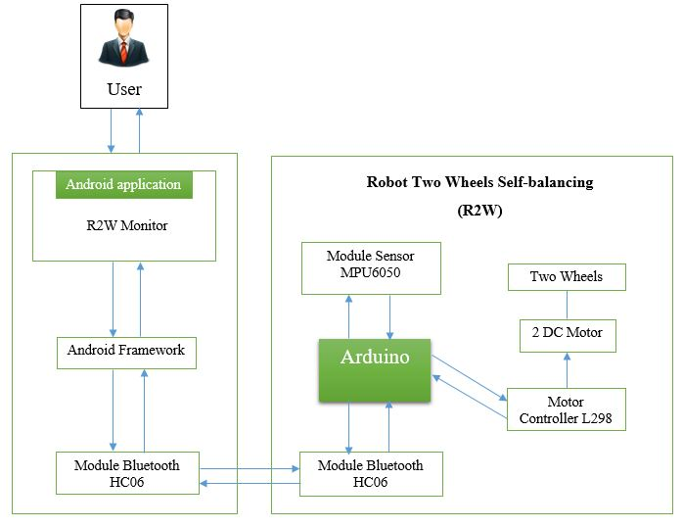
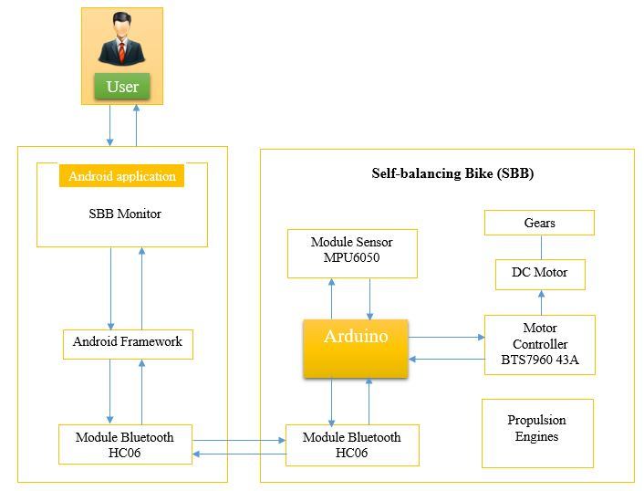
Overview Amazing Bike System

Slide 18
3.
Research and Study
3.1
Physical Theory
3.2
PID
3.3
Modules and Communication

Slide 19





Robot’s Self Balance Theory
3.1 Physical Theory
$$\vec{P_{1}}$$
$$\vec{N}$$
$$\vec{P}$$
$$\vec{F_{in}}$$
$$\vec{F_{in}′}$$

Slide 20





Bicycle’s Self Balance Theory
3.1 Physical Theory
$$\vec{v}$$
$$\vec{F_{qt}}=\frac{mv^{2}}{R}$$
$$\vec{F_{qt}}$$
$$\vec{P_{1}}$$
$$\vec{P}$$

Slide 21
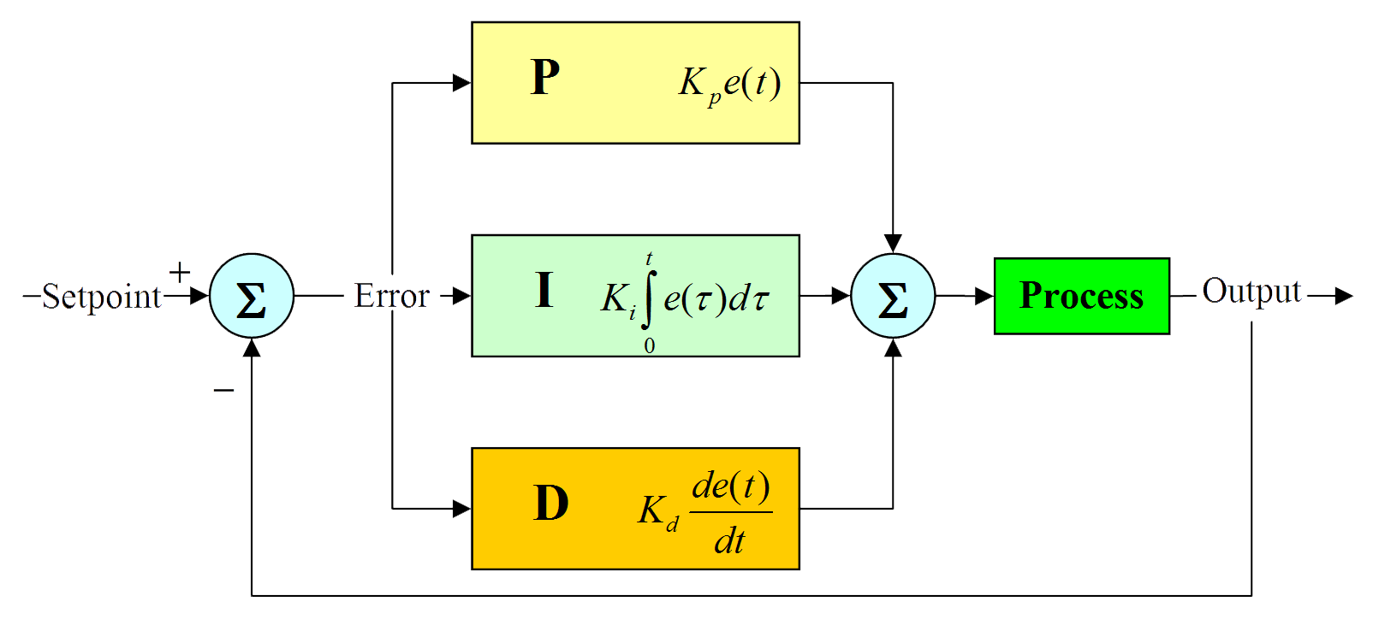
Proportional Integral Derivative
3.2 PID

Slide 22
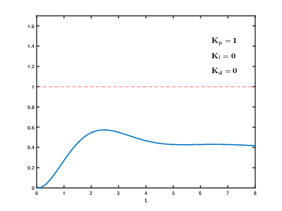
Effects of varying PID parameters
3.2 PID

Slide 23
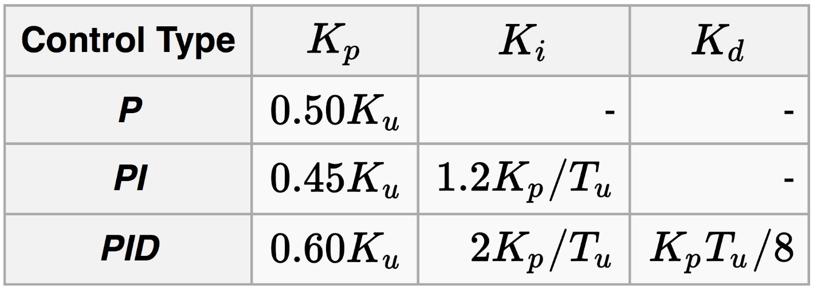
Ziegler–Nichols method
3.2 PID

Slide 24
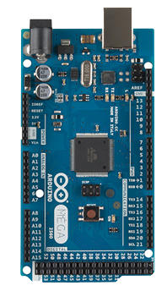
3.3 Modules and Communication
Microcontroller | ATmega2560
Operating Voltage | 5V
Input Voltage (recommended) | 7-12V
Input Voltage (limit) | 6-20V
Digital I/O Pins | 54 (of which 15 provide PWM output)
Analog Input Pins | 16
DC Current per I/O Pin | 20 mA
DC Current for 3.3V Pin | 50 mA
Flash Memory | 256 KB of which 8 KB used by bootloader
SRAM | 8 KB
EEPROM | 4 KB
Clock Speed | 16 MHz
Length | 101.52 mm
Width | 53.3 mm
Weight | 37 g
Arduino
Mega 2560

Slide 25
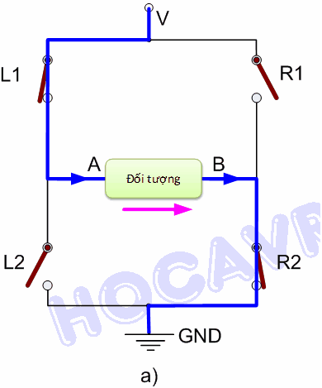
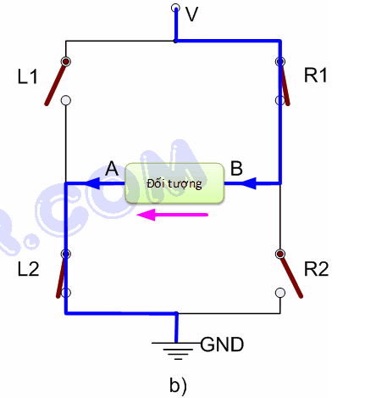
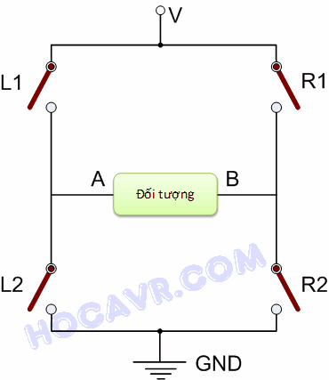
3.3 Modules and Communication
H-Bridge
Operating principle

Slide 26
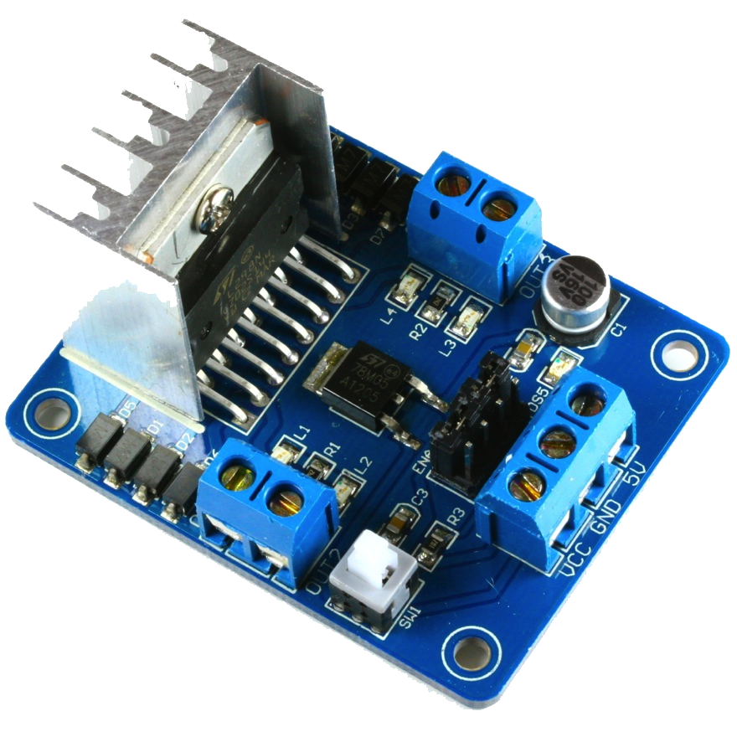
3.3 Modules and Communication
Driver: L298N integrated dual H-bridges.
Power supply: +5 V ~ +35 V
Peak output current per channel: 2A
Logic power output Vss: +5 V ~ +7 V
Logic current: 0 ~ 36ma
Max power: 20W(Temperature 75 Cesus)
Working temperature: -25 ℃ ~ +130 ℃
ENA = 0: Motor doesn’t rotate with all inputs.
ENA = 1:
INT1 = 1; INT2 = 0: Motor moves forward.
INT1 = 0; INT2 = 1: Motor moves reverse.
INT1 = INT2: Fast Motor stops
ENB similar with INT3, INT4
Module
Control Engine
L298

Slide 27
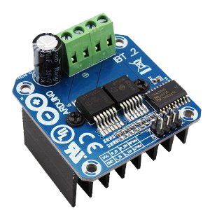
3.3 Modules and Communication
Double BTS7960 large current (43 A) H bridge driver.
5V isolate with MCU, and effectively protect MCU.
5V power indicator on board.
Voltage indication of motor driver output end.
Can solder heat sink.
Just need four lines from MCU to driver module (GND. 5V. PWM1. PWM2).
Isolation chip 5 V power supply (can share with MCU 5 V).
Able to reverse the motor forward, two PWM input frequency up to 25kHZ.
Two heat flow passing through an error signal output.
Isolated chip 5V power supply (can be shared with the MCU 5V), can also use the on-board 5V supply.
The supply voltage: 5.5V to 27V.
Module
Control Engine
43A BTS7960

Slide 28
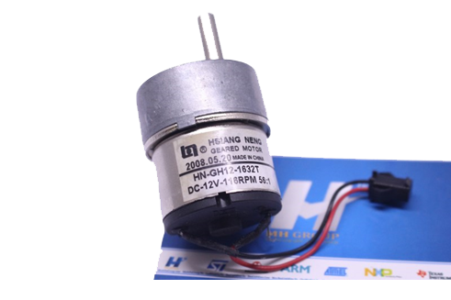
3.3 Modules and Communication
Output: 2W
Voltage: 12V
Field No Download: 70mA
Speed: 116RPM 12V
Speed over voltage: 5-> 15V speed 48-> 145RPM
Weight: 120 g
Gear motors
12V 116RPM
GH-1632T

Slide 29
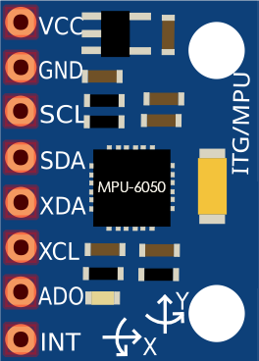
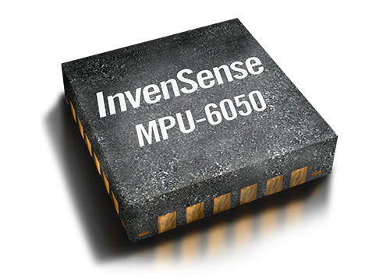
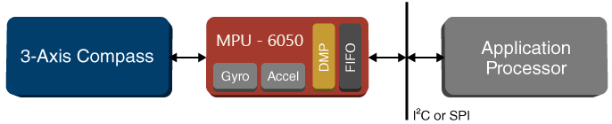
3.3 Modules and Communication
The world’s first MotionTracking devices designed for the low power, low cost, and high-performance
It contains :
GY-521 breakout board
MPU-6050
Six-Axis
MEMS

Slide 30
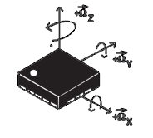
3.3 Modules and Communication
The gyroscope measures Angular Rate using the Coriolis Effect.
Positive
Negative
Quick response to a change in angle
On the short term, the data from the gyroscope is very precise
Readings at certain time intervals.
More processing time for better tilt angle accuracy
Drift over time
Gyroscope
3 axis
MEMS

Slide 31
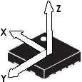
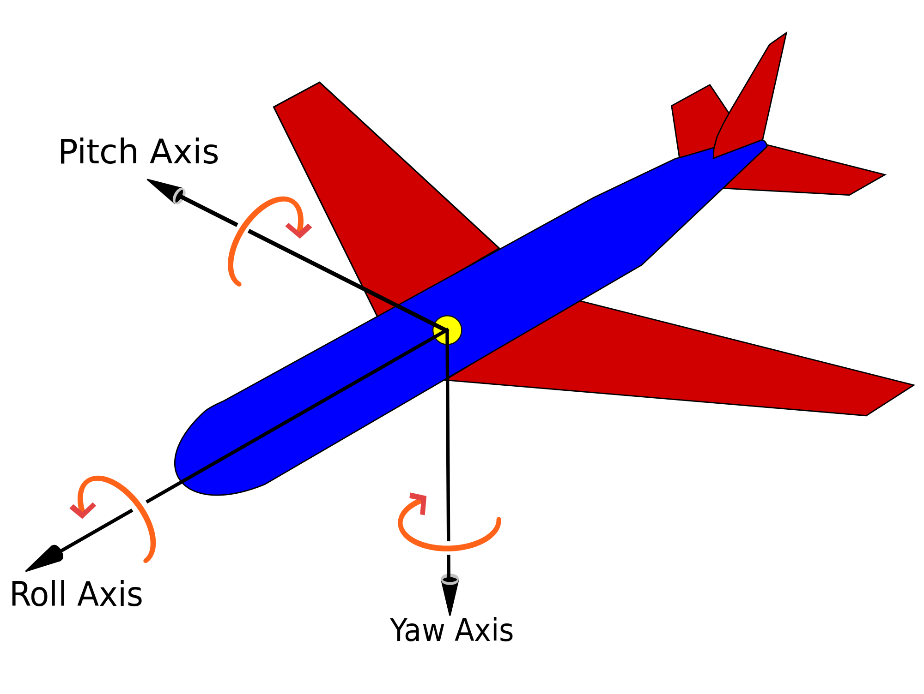
3.3 Modules and Communication
Accelerometers measure Linear acceleration.
Positive
Negative
If not moving, accelerometer will give accurate reading of tilt angle
On the long term, the data from the accelerometer is precise
Accelerometers are slower to respond than Gyro's
Accelerometers are prone to vibration/noise
Accelerometer
3 axis
MEMS

Slide 32
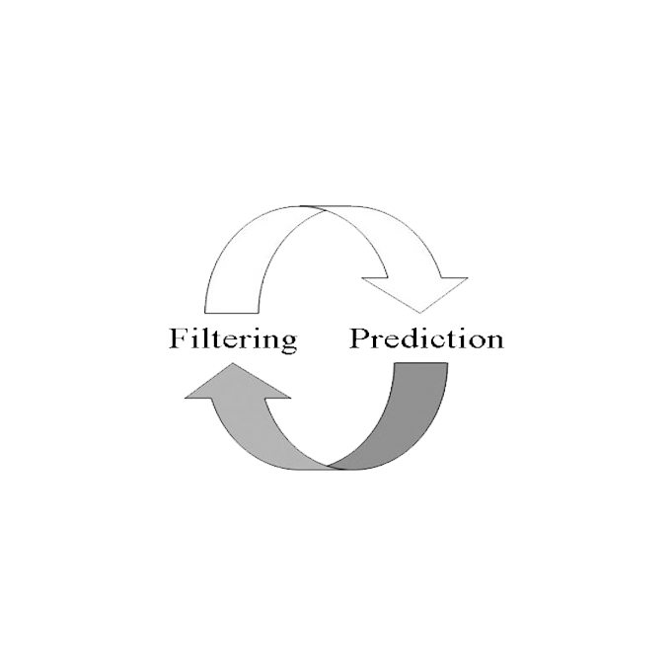
3.3 Modules and Communication
The Kalman filter is one of the most important and common data fusion algorithms in use today
Used to mix and merge the two values, in order to have a correct value
Negative
Difficult to understand (mathematics)
Need to calculate a lot of thing (coefficients of the matrices, measurement error …).
Kalman
Filter

Slide 33
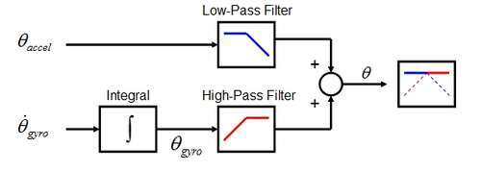
3.3 Modules and Communication
Complementary Filter manages both high-pass and low-pass filters simultaneously
Positive
Complementary
Filter
The filter is light to implement
Simple
Data is quite good enough.

Slide 34
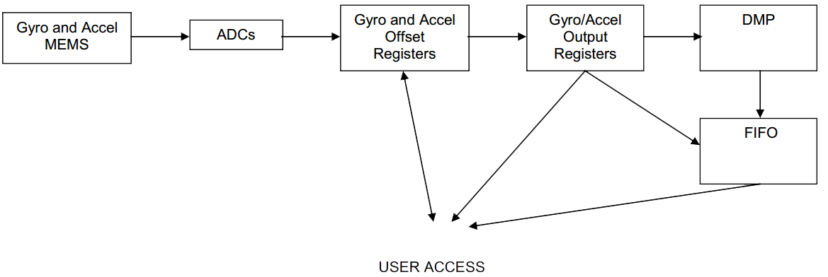
3.3 Modules and Communication
Processor which is located within the MPU-6050
Purpose : offload both timing requirements and processing power from the host processor.
DMP
Digital
Motion
Processor
User Access

Slide 35
3.3 Modules and Communication
Complementary Filter’s Data
DMP’s Data
Conclusion

Slide 36
3.3 Modules and Communication
Causes :
- Trim errors
- Mechanical stresses
- Temperature , aging…
Tolerance : Up to +- 12 degrees
Calibrate offset :
Place MPU6050 in horizontal position
Ax = Ax = Gx = Gy = Gz =0 , Az = 1G
Offsets
Measure the average acceleration and gyroscope over 10-20 samples
Anything over 0 in the Ax, Ay, Gx, Gy, Gz and
1G in Az will be our offsets

Slide 37
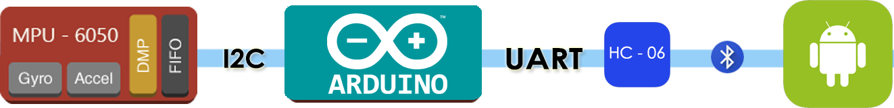
3.3 Modules and Communication
Protocols :
- I2C
- UART
- Bluetooth
Communication
Communication between modules in Project

Slide 38
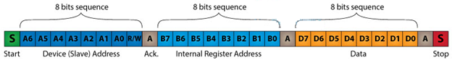
3.3 Modules and Communication
I2C
- Synchronous serial communication protocol
- Master-Slave model
- Two wires are used : SCL, SDA.
I2C
Inter
Integrated
Circuit
How it works

Slide 39
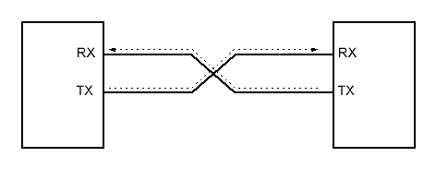
3.3 Modules and Communication
UART
- Asynchronous serial communication protocol
- Two wires are used : RX, TX.
UART
BLUETOOTH
Bluetooth
A wireless technology standard for exchanging data over short distances.

Slide 40
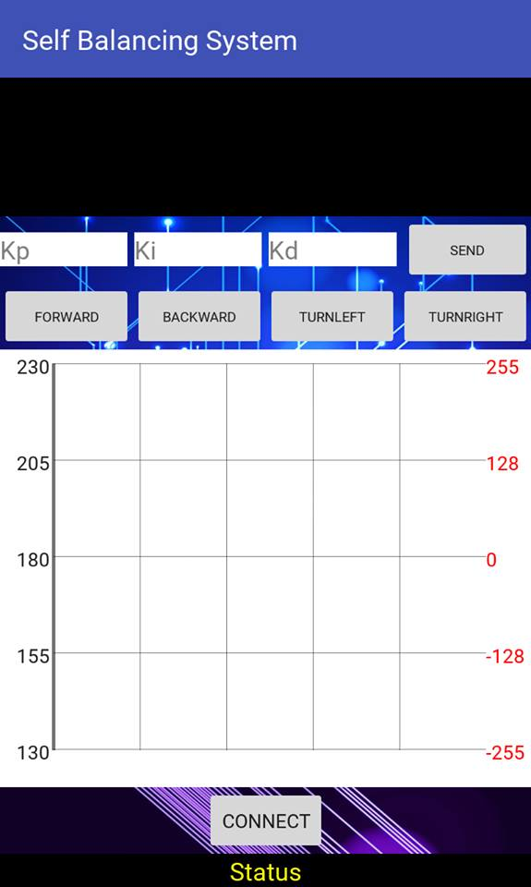
ANDROID APPLICATION
Log Activity both from Android and Arduino.
Set PID Constants.
Control Movement
Log PID’s Input and Output (Tilt Angle and PWM)
Searching Bluetooth devices and connect.
Bluetooth connection’s status.

Slide 41
4.
Product Demo

Slide 42

Progress Overview

Slide 43
Product Demo

Slide 44
5.
Question and Answer

Slide 45
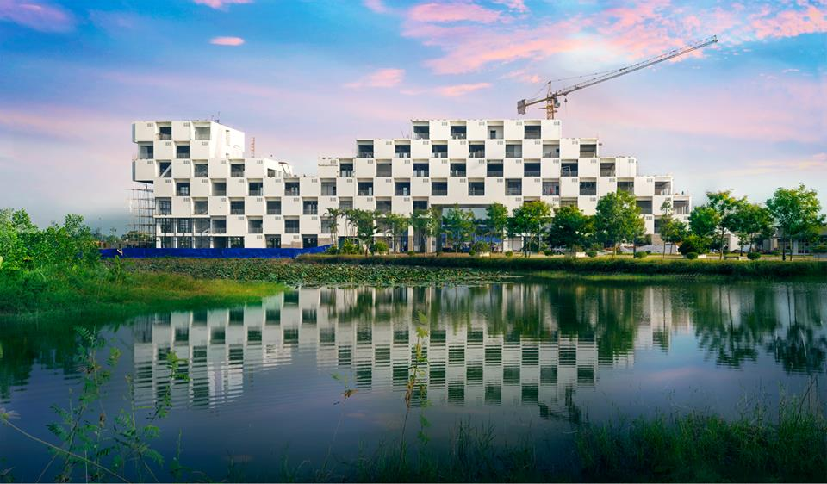
Thanks
For
Listening

